Slide 1

SLIDE 1
Team Name - DALCV_CODE_WITH_US
2. Members Name and Phone Numbers
Sreeram Divya Sri(Leader) * (3rd year) ph.no: 9150466889
Nerella Sai(3rd year) ph.no: 9390083836
A.Sai Charish (3rd year) ph.no: 7386347481
Vara Lakshmi Yimani (3rd year) ph.no: 6309807747
K.Lahari (3rd year) ph.no: 6304918170
3. Domain name - OPEN INNOVATION

Slide 2
SLIDE 2
PROBLEM STATEMENT
Maximum number of farmers are uneducated . They are not aware of agricultural technologies. They are still using traditional practices . They are travelling long distances just to get to know about their soil fertility , crop problems, to get good fertilizers, pesticides. And so many are facing weather related problems. Regulation of water in their agricultural lands on time basis and they are facing difficulties to sell their crop at their desired prices, farmers are facing difficulties in calculating profit loss .and some novice farmers find difficulties to farm
After some period, when farmers find no crops to be grown they can use crop rotation technique and some plants require more fertility for their growth while others require less. So we included crop rotation methodology through which farmer can gain knowledge on this .to know more or get practical knowledge, farmers can see youtube videos which will be included in the website. This pandemic situation has affected all domain people and there was a huge economic loss.It affected farmers all over the world. So through this website ,we are providing future pandemic prediction technology using artificial intelligence

Slide 3
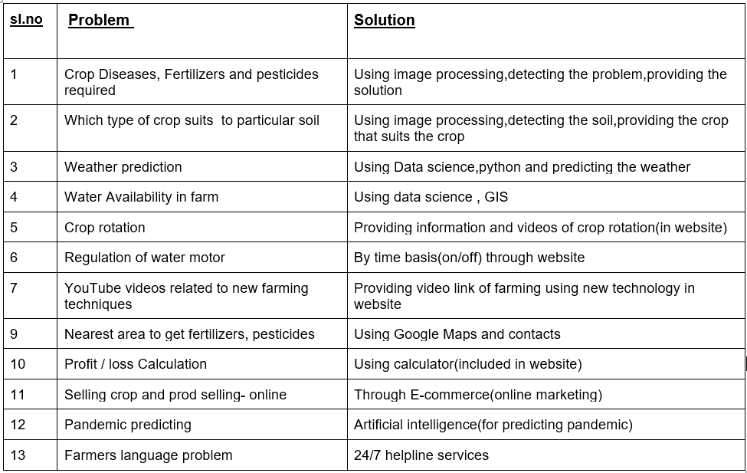
SLIDE 3
soil
,Water resource management

Slide 4
SLIDE 4
NOVELTY
Generally, farmers cannot detect most of the diseases of their crops, so using our website(by image processing) farmers can take an image of their crop and upload it and come to know what problem the crop is having and use the particular pesticides and insecticides. We can also detect which crop suits the particular soil .Some Farmers are unaware of Crop rotation, so through this website, farmers can get complete knowledge of crop rotation and farming techniques. Farmers can sell their crops online at their desired rates to corporate companies without brokerage. 24/7 Helpline services are also provided. This website provides complete statistics of soil, weather, water available, and pesticides to be used for the crops. Other websites mostly do not contain all the above features. But we have identified major problems facing by the farmers and we have provided solutions to those problems. Thus our website stands out from other existing websites.

Slide 5
SLIDE 5
METHODOLOGY
Image Processing for plant disease:
For the proposed methodology there are nearly five
excluding the input image and pre –processing the
image. The stages are like this
1.Convert RGB image into lab space
2.Image Segmentation
3.K-means clustering algorithm
4.Feature extraction
5.SVM (Support Vector Machine) tool
These are the five stages that input image undergoing the processes. By using the digital cameras taken the photo of the plant leaf and taken it as the input image. The input image will undergo for the pre-processing stage. The various pre-processing image techniques are like image contrast, image enhancement, image cropping and removing noises if any is present. Image segmentation is the further stage which divided the input digital image into ROI (region of interest). Segmentation is done by using the K-means clustering algorithm, to segment the leaf image by analysing the a*b*L colour space. Feature extraction is the terrible stage in the image processing. In this feature extraction the values which are obtained we are taking them as for the disease classification. For disease classification SVM (Support Vector Machine) classifier technique is used. If the leaf is not affected any disease it will throw, “healthy” message on the output screen. If the leaf is affected any disease then it will throw, “disease affected” message on the screen. In the image segmentation process the segment of the leaf image is analysed by the values are a* b* L. where, a shows the colour drop along the red-green-blue, b shows the shading drop and L is the chromaticity layer

Slide 6
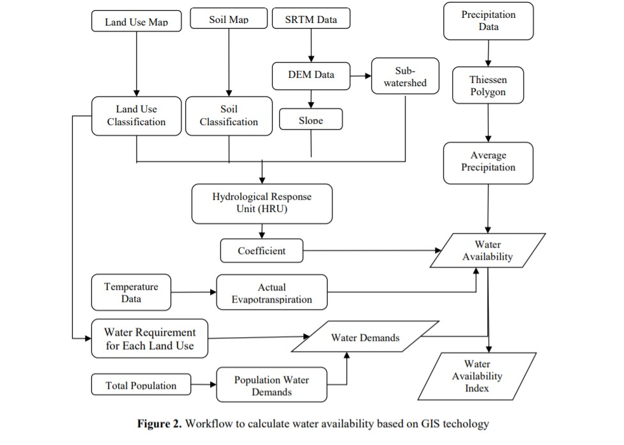
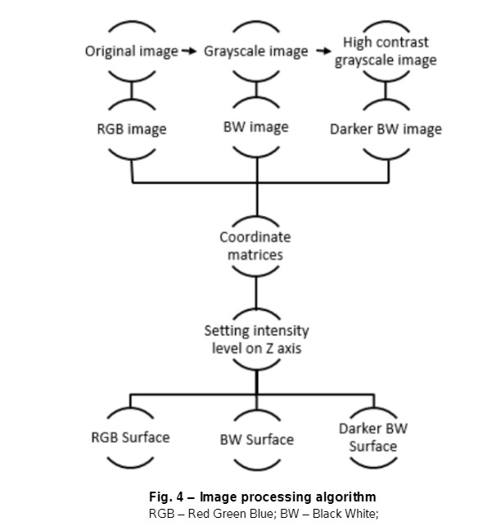
SLIDE 6
METHODOLOGY & ALGORITHM
Water availability algorithm
Image Processing

Slide 7
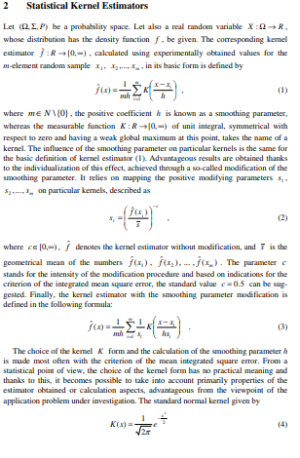
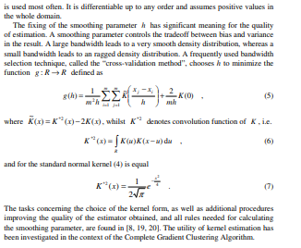
SLIDE 7
METHODOLOGY & ALGORITHM

Slide 8
SLIDE 8
BUSINESS SCOPE
Nowadays most of the farmers have smart phones with them. In 3-4 years at least 90% of the farmers will be having smartphones. So there's a huge scope for learning farming and solving major problems faced by farmers through this website. Farmers can use this website for free. They can also communicate with the concerned authorities using help lines in their regional language.
Novice farmers can also learn farming from this website. As There will be wide usage of this website in a few years,There is a huge scope for this website in the market.

Slide 9
SLIDE 9
Implementation
We have implemented the following features in the website:
Weather prediction
Crop rotation
Buy and sell products Cart
Calculate profit and loss
Farmers guide
Find out the problem in crops (upload an image)
Pandemic prediction
Soil detection
Plant disease detection

Slide 10
SLIDE 9
RESULTS AND DISCUSSION
The final result of the project has been uploaded to the github repository. The screenshots of our implementation have been added and shown the slides below. We have implemented most of the features we planned on implementing. And this is a prototype of the website. The image processing couldn’t be integrated with front-end web dev part. But those two modules have been implemented separately
Gitub repository link: https://github.com/lakshmi0512/DALVC_CODE_WITH_US.git

Slide 11
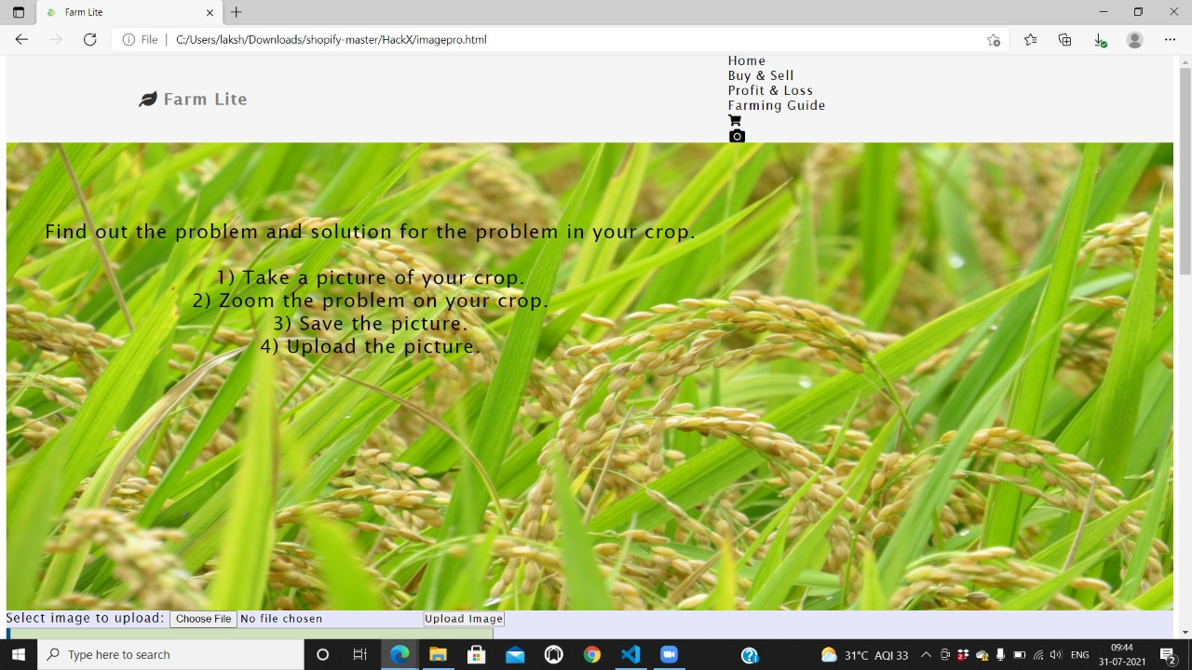
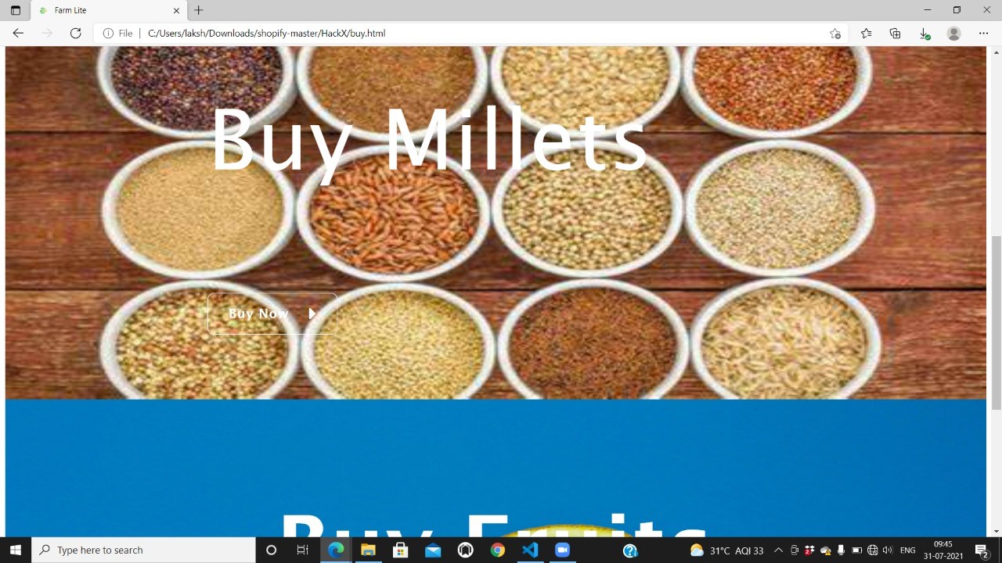
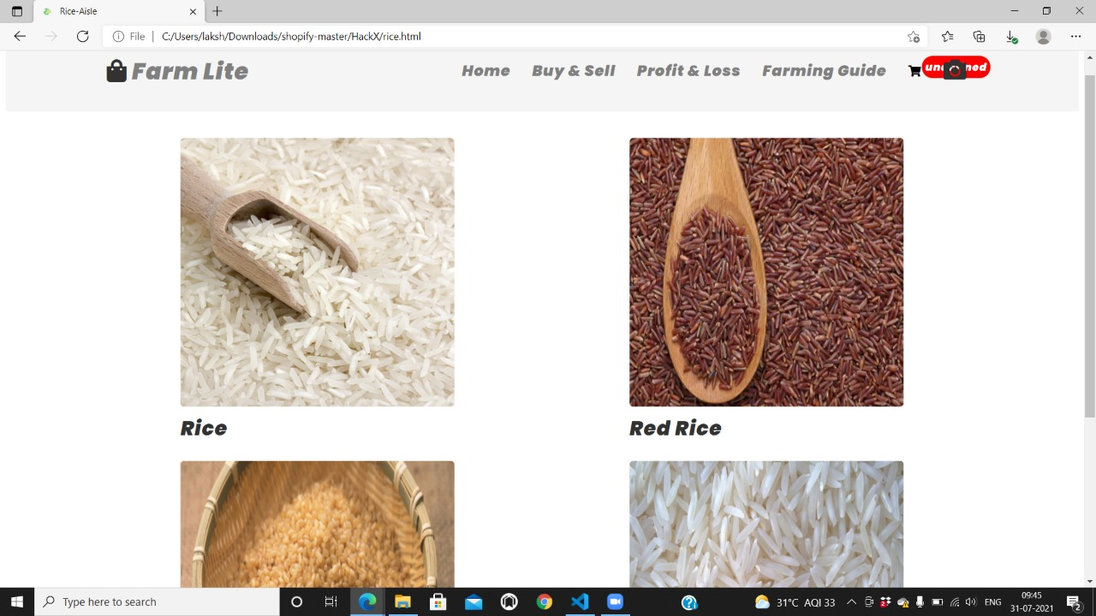
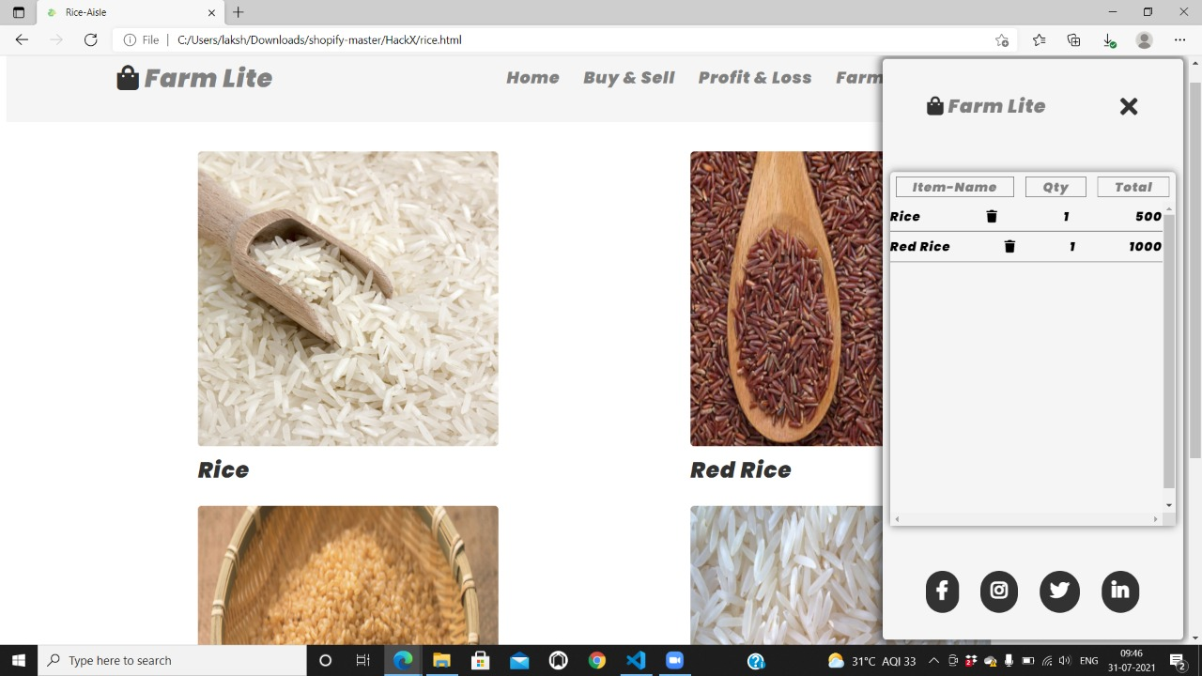
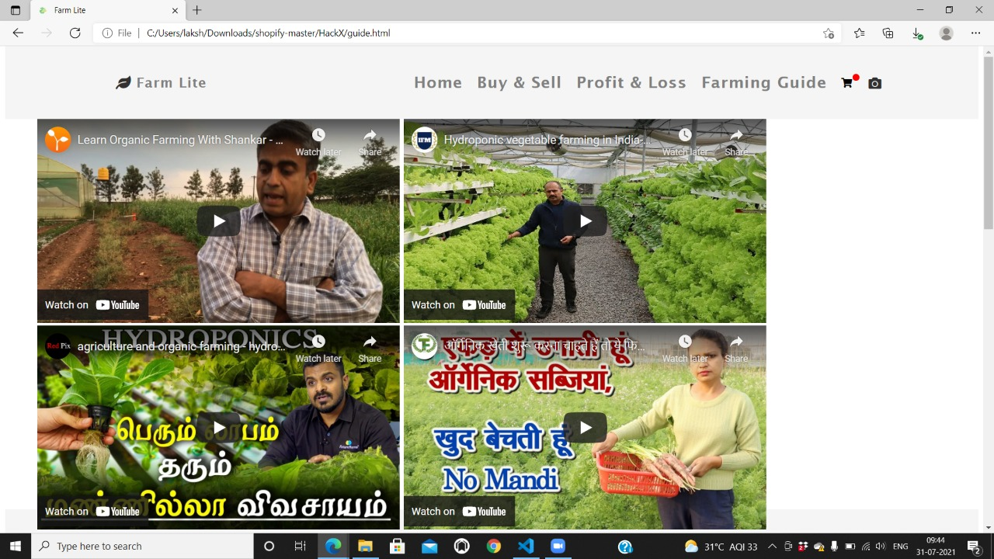
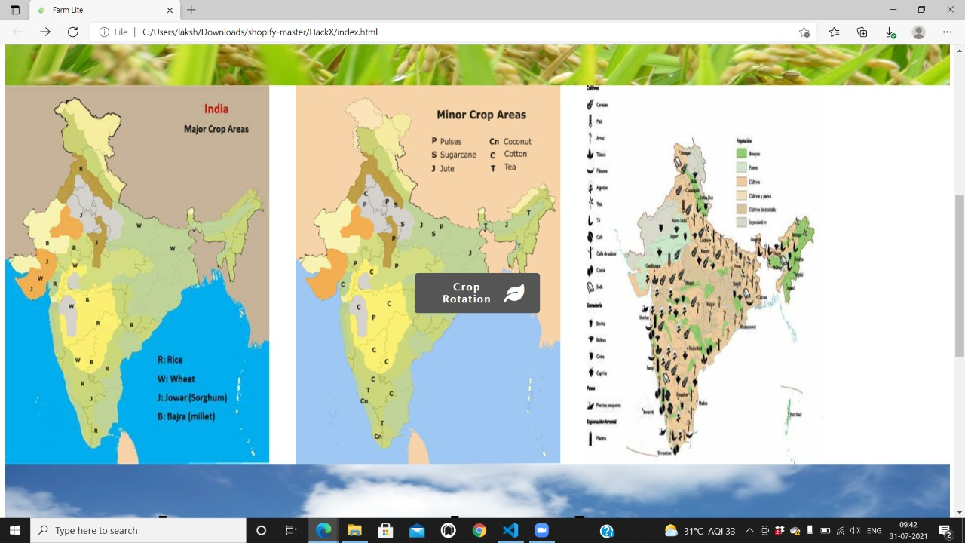
SLIDE 11

Slide 12
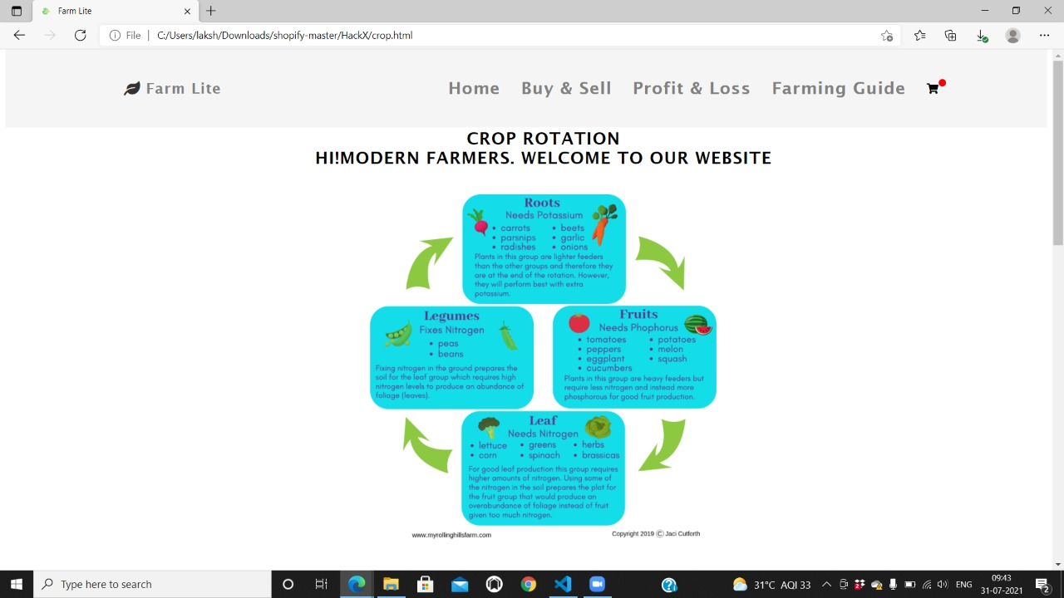
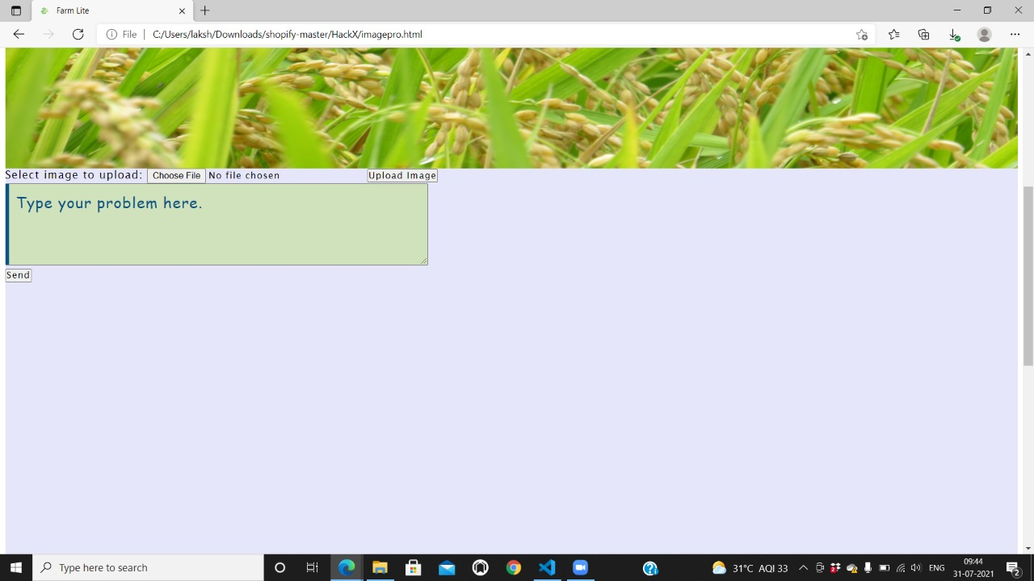
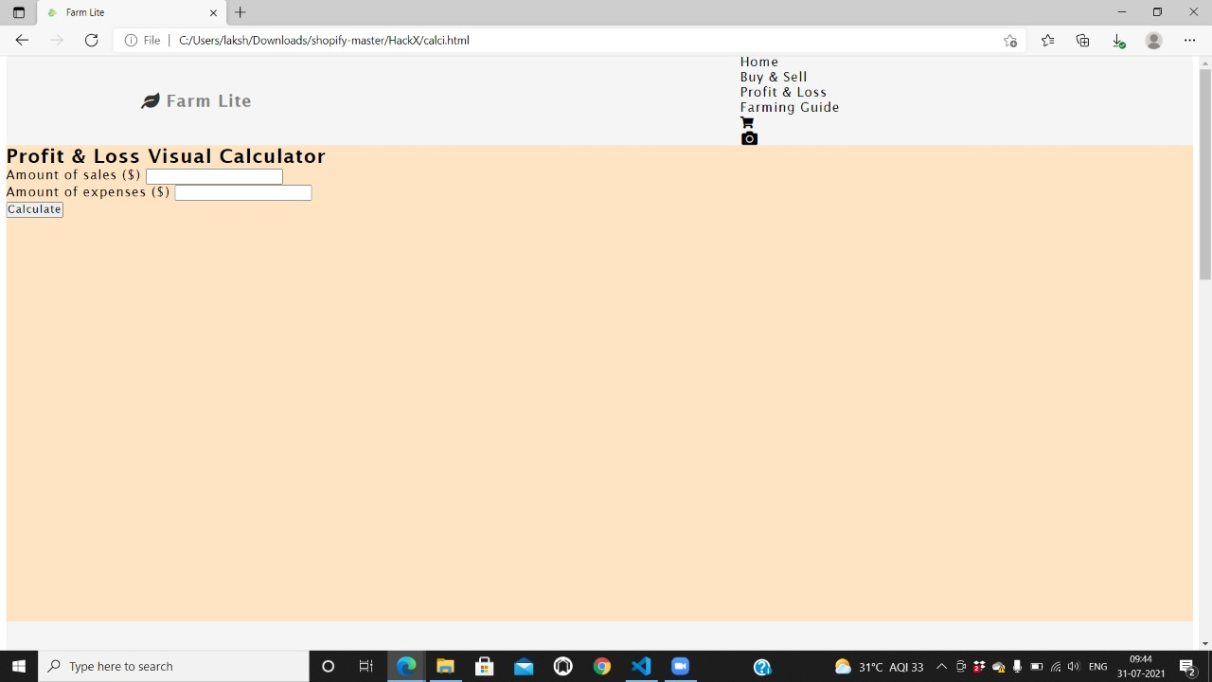
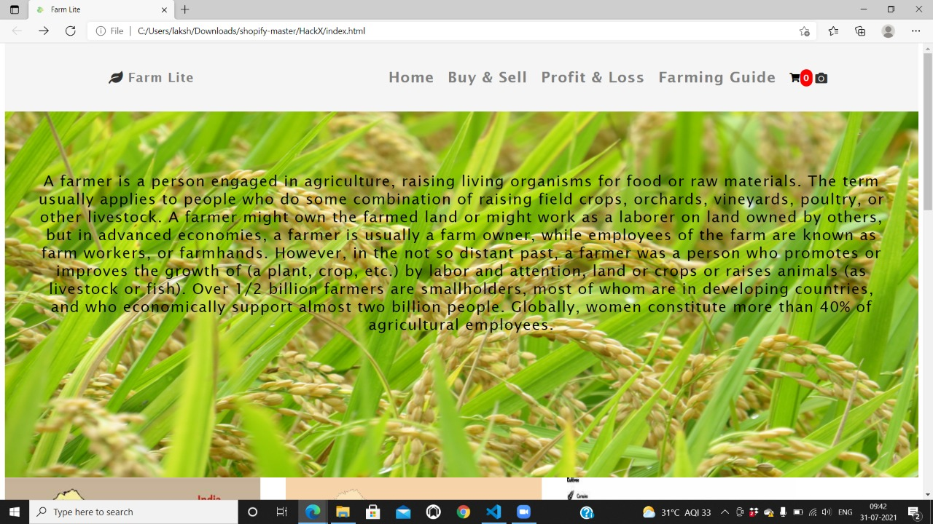
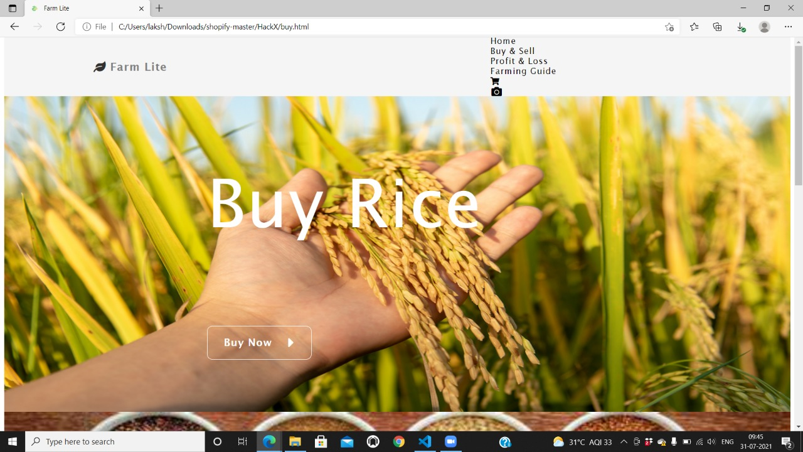
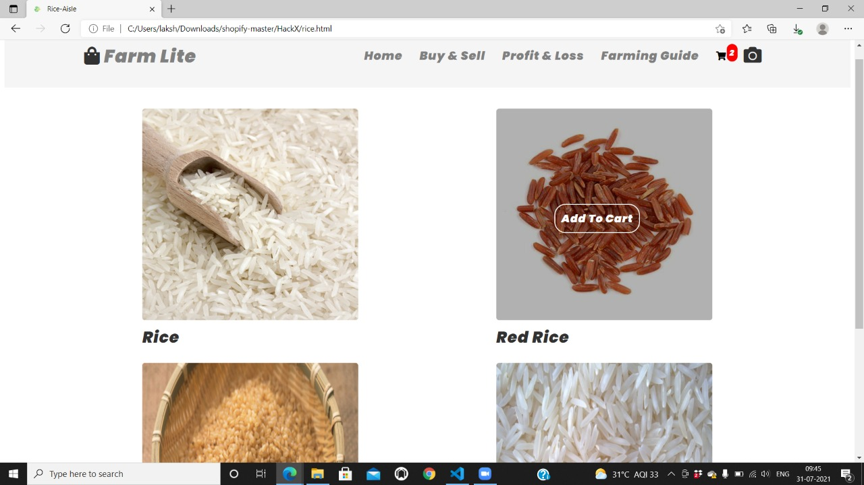
SLIDE 10 -IMPLEMENTATION

Slide 13
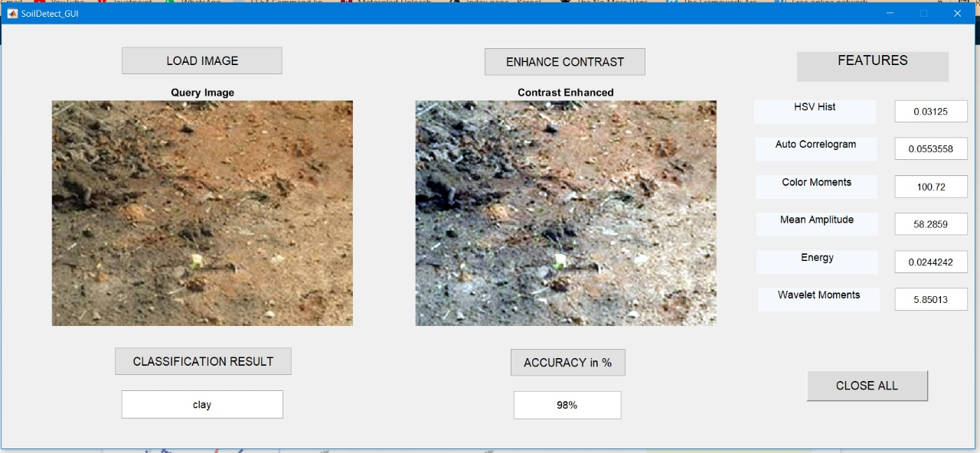
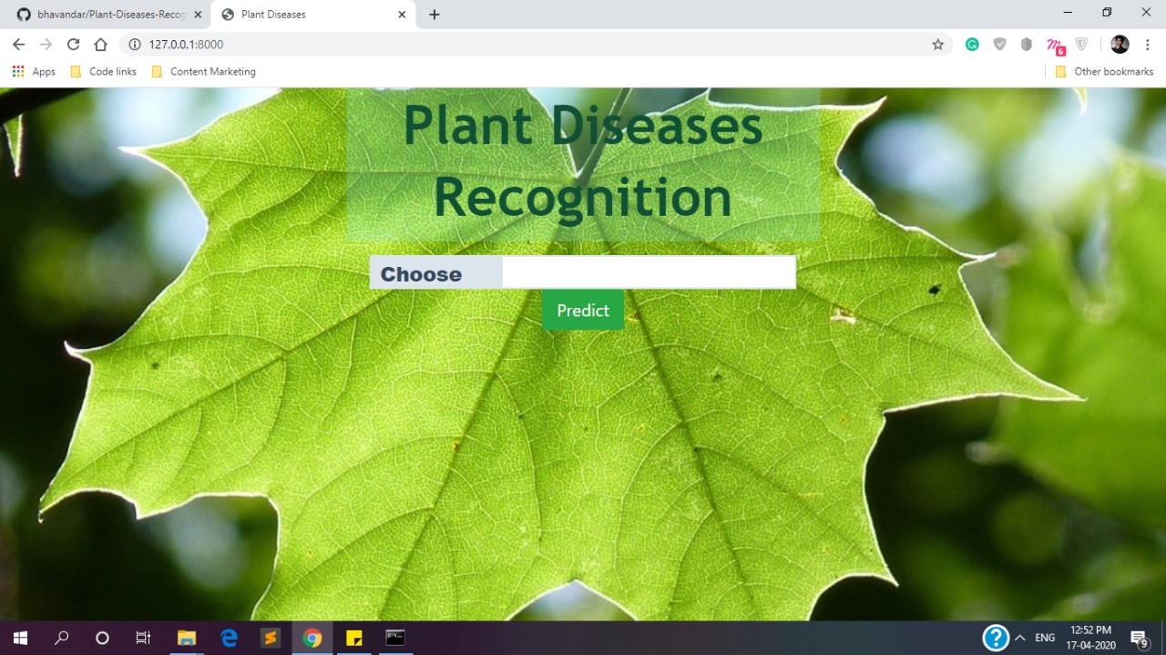
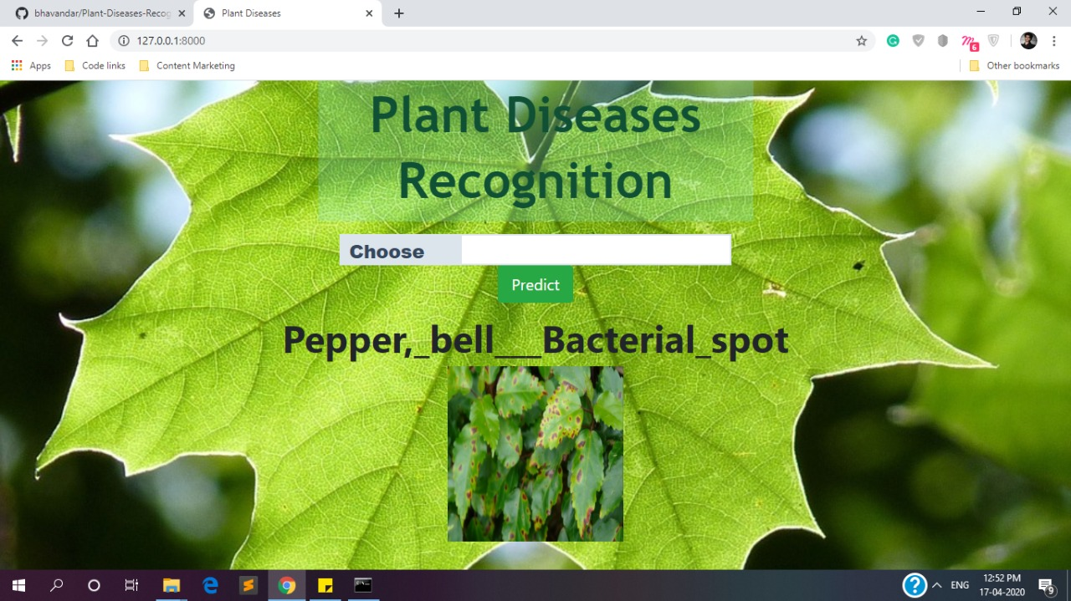
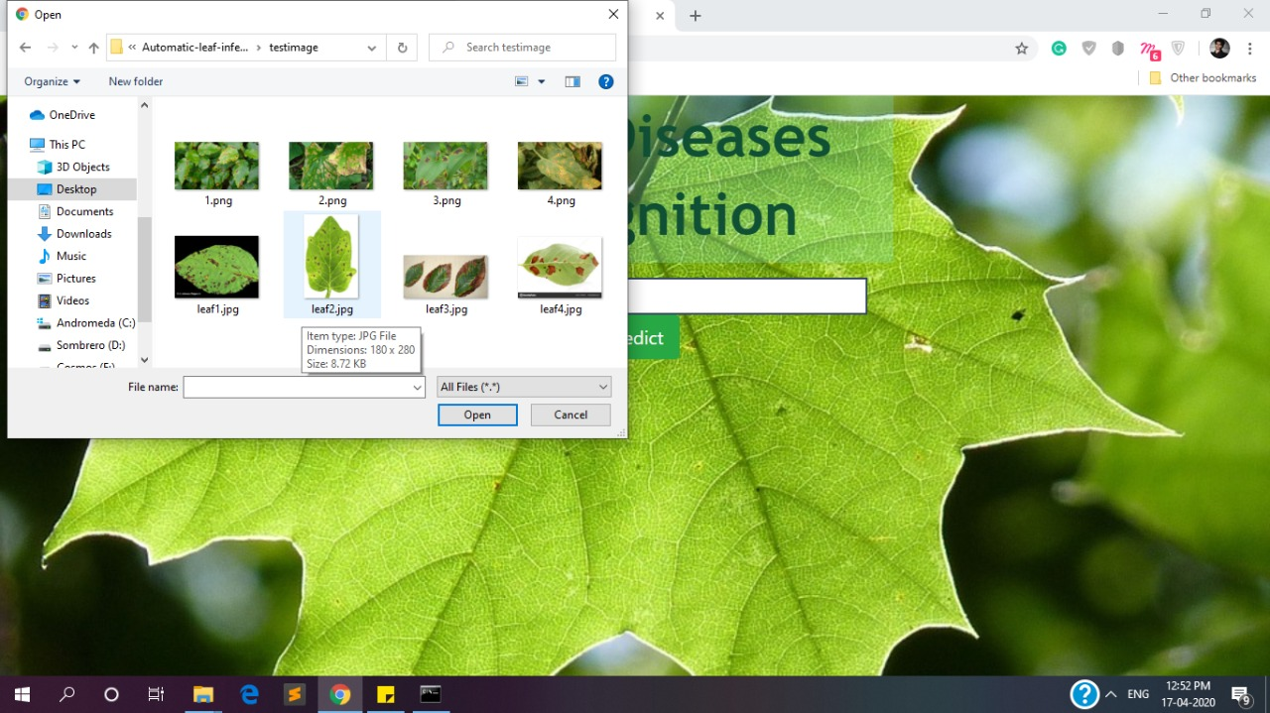
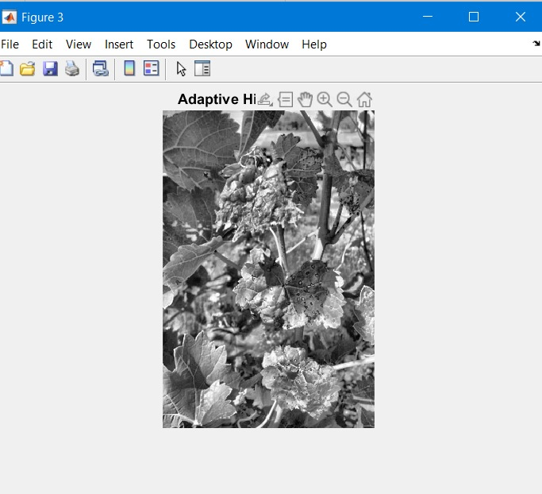
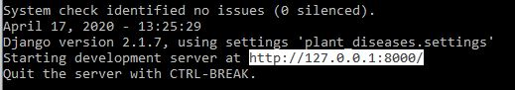
SLIDE 12

Slide 14
SLIDE 13
Thank you!!

